Slide 1

WEEK 6 · PRACTICAL ASSESSMENT REPORT
VAPT Project Report
Web Security & Vulnerability Assessment and Penetration Testing
OWASP Top 10 Study · DVWA Testing · Burp Suite & OWASP ZAP Analysis
Prepared by
Md Mohtasim (DG/JULY/CYBER/017)
Role
Cyber Security Intern
Target system
http://localhost/dvwa/
Tools used
Kali Linux · DVWA · Burp Suite CE · OWASP ZAP · Firefox
Submission date
14 September 2026

Slide 2


SECTION 1 · INTRODUCTION
What is VAPT, and why it matters
Vulnerability Assessment and Penetration Testing (VAPT) is a structured security-testing practice used to identify, evaluate, and address weaknesses before attackers can exploit them. For web apps, it focuses on the application layer — input handling, sessions, authentication, and server configuration — using the OWASP Top 10 as its theoretical basis.
SCOPE OF THIS PROJECT
PRIMARY TARGET
Vulnerability Assessment (VA)
Damn Vulnerable Web Application (DVWA) — intentionally flawed, for training, in a local/isolated lab
Systematic review to identify, classify, and prioritize known vulnerabilities using automated scanning tools.
OPTIONAL TARGET
Penetration Testing (PT)
testphp.vulnweb.com — a public, legal test site
Simulated, hands-on attack to actively exploit vulnerabilities and determine real-world breach impact.
OUT OF SCOPE
WHY IT MATTERS
No production system or unauthorized third-party application was tested
Finds gaps before attackers do · supports compliance (ISO 27001, PCI-DSS, GDPR) · reduces breach/financial/reputational risk · guides remediation
METHOD
Week-long, lab-based exercise to safely study and reproduce vulnerabilities
02

Slide 3




SECTION 2 · OWASP TOP 10
Four vulnerability classes studied in depth
The OWASP Top 10 is refreshed periodically from real-world breach data. This project studied four categories through hands-on lab testing.
2.1
2.2
2.3
2.4
SQL Injection
Cross-Site Scripting
Broken Authentication
Security Misconfiguration
Untrusted input alters SQL query logic — bypasses auth or extracts data. Payloads like admin' -- skip the password check entirely.
Untrusted data runs as script in another user's browser. Reflected, Stored, and DOM-based variants studied.
Flaws in login, session, and credential handling compromise identity — weak creds, no lockout, exposed session IDs.
Insecure defaults or unmaintained settings widen the attack surface — verbose errors, missing headers, outdated software.
03

Slide 4


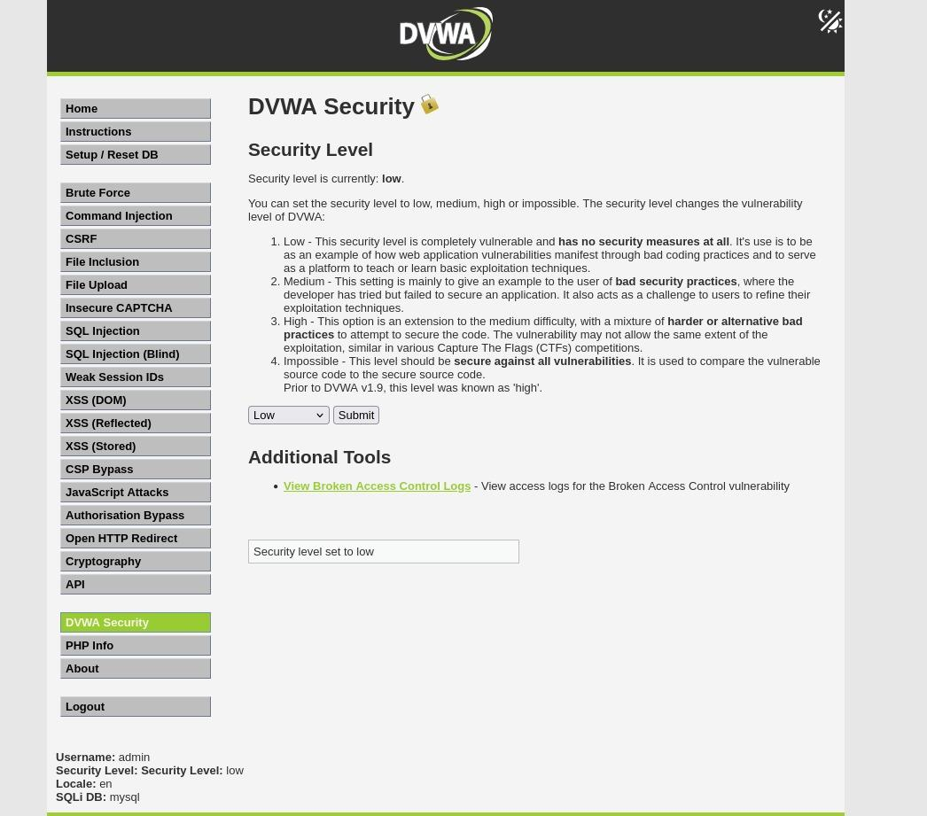
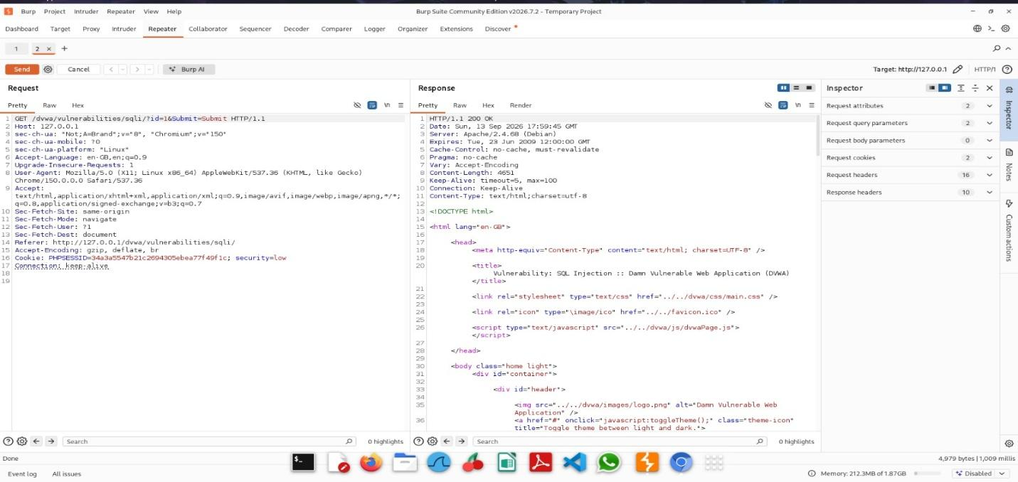
SECTION 3 · TOOLS & TESTING PROCESS
Tools, environment & manual exploitation
Burp Suite CE
OWASP ZAP
DVWA
Intercepting proxy — Proxy, Repeater, Site map, Decoder — captures & modifies HTTP traffic.
Free DAST tool for automated crawling and active-scanning, flagged by risk level.
PHP/MySQL app with known flaws; adjustable Low/Medium/High/Impossible security levels.
MANUAL TESTING STEPS
1
Baseline & payload
Normal User ID observed, then classic payloads tested: 1' OR '1'='1 and UNION SELECT user, password FROM users -- -
2
Capture in Burp Suite
Proxy at 127.0.0.1:8080 intercepts requests; Repeater resends with modified payloads.
Fig. 1 — DVWA security level configuration
3
XSS payloads
<script>alert('XSS')</script> submitted via forms; repeated at higher security to test filter bypass.
04

Slide 5
SECTION 2.1 – 2.2 · INJECTION & SCRIPTING
SQL Injection & Cross-Site Scripting
SQL Injection
Cross-Site Scripting
Reflected — in the request, immediately echoed back. Stored — saved server-side, runs for every visitor. DOM-based — client-side JS mishandles data.
Input: admin' --
Query becomes: ...WHERE username='admin' -- ' AND password='';
<script>alert('XSS')</script>
Everything after -- is a SQL comment, so the password check is skipped.
IMPACT: unauthorized data access · auth bypass · data modification · in some cases, remote command execution
IMPACT: session hijacking via cookie theft · page defacement · phishing redirection · keystroke logging
VARIANTS: In-band (Union/Error) · Blind (Boolean/Time) · Out-of-band
Basic filters (stripping <script>) can be bypassed with alternate encodings — blacklists are unreliable defenses.
BROKEN AUTHENTICATION
SECURITY MISCONFIGURATION
Weak/default credentials · no lockout or rate limiting · exposed session IDs · weak password hashing
Default accounts enabled · directory listing exposed · verbose errors · missing security headers · outdated software
05

Slide 6
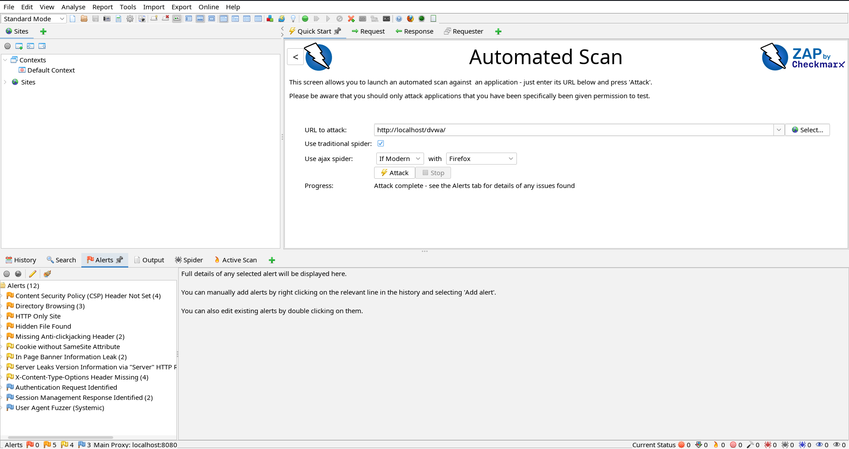
SECTION 5 · AUTOMATED SCANNING
Automated scan using OWASP ZAP
SCAN PROCESS
TYPICAL FINDINGS ON DVWA
1
Target URL entered in ZAP's Quick Start tab
Alert | Risk | Confidence
SQL Injection | High | Medium
Cross Site Scripting (Reflected) | High | Medium
Missing Anti-CSRF Tokens | Medium | Low
X-Content-Type-Options Header Missing | Low | Medium
Server Leaks Version Information | Low | High
2
Spider run to crawl & map reachable pages
3
Active Scan sends test payloads to every parameter
4
Alerts reviewed by risk: High / Medium / Low / Info
5
Results exported via Report → Generate Report
The ZAP scan surfaced categories consistent with manual testing, plus configuration-level issues — including missing CSP, directory browsing, and cookies without SameSite — reinforcing that automated coverage complements manual exploitation.
Fig. 9 — ZAP Alerts panel from the DVWA scan
06

Slide 7
SECTION 6 · FINDINGS & MITIGATION
Consolidated findings & risk levels
# | Vulnerability | Location / Module | Risk | Mitigation
1 | SQL Injection | DVWA – SQL Injection module | High | Parameterized queries; least-privilege DB accounts
2 | Reflected / Stored XSS | DVWA – XSS modules / Guestbook | High | Output encoding; strict CSP; HttpOnly cookies
3 | Broken Authentication | DVWA – Login / Brute Force | Medium | Account lockout, MFA, salted hashing (bcrypt/Argon2)
4 | Security Misconfiguration | Server / DVWA configuration | Medium | Patch software; disable verbose errors; harden config
5 | Missing Security Headers | Application-wide (via ZAP) | Low | Apply CSP, X-Frame-Options, X-Content-Type-Options, HSTS
RISK RATING · simplified Likelihood × Impact, aligned with OWASP Risk Rating Methodology
High: Easily exploitable, no auth required
Medium: Exploitable with conditions/interaction
Low: Difficult to exploit directly
Root cause common to all findings: insufficient validation of untrusted input and overly permissive default configurations.
07

Slide 8

CONCLUSION
From theory to hands-on exploitation
This project provided hands-on exposure to the core VAPT methodology — from studying OWASP Top 10 theory, through reproducing real exploits in a safe lab (DVWA), to capturing and analyzing traffic manually (Burp Suite) and running automated scans (OWASP ZAP).
KEY TAKEAWAY
Applying the mitigations identified — parameterized queries, output encoding, strong authentication controls, and secure configuration management — would address every vulnerability found and substantially reduce the application's attack surface.
Most high-impact web vulnerabilities — SQLi, XSS, broken authentication, misconfiguration — stem from a common root cause: insufficient validation of untrusted input and overly permissive defaults.
Automated tools (ZAP) give efficient broad coverage; manual testing (Burp Suite + hands-on payload crafting) confirms true positives and catches what scanners miss — the two are complementary.
08

